Slide 1

Advanced Corporate Finance (LL4554V/LL5554V/LLJ5554V/LL6554V) 8. Efficient Market Hypothesis
Kenneth Khoo
kenneth.khoo@nus.edu.sg

Slide 2

Efficient Market Hypothesis
Financing Decisions Are Zero NPV in Efficient Markets.
The Efficient Market Hypothesis.
Three Forms of Market Efficiency.
Implications of Market Efficiency.
What EMH Does Not Imply.
The Evidence: Are Markets Efficient?
Behavioral Finance.
Limits to Arbitrage.

Slide 3
Investment vs. Financing Decisions
Investment decisions involve acquiring real assets (plant, equipment, technology).
Financing decisions involve selling financial assets (stocks, bonds, loans) to raise capital.
Key Differences:
Investment decisions can have positive NPVs because real asset markets are often imperfectly competitive (patents, unique skills, brand, etc.).
Financial markets are much more competitive than real asset markets.
It is harder to find positive-NPV financing opportunities because there are fewer barriers to entry and information travels fast.
Result: In efficient financial markets, the sale of a security generates a fair price. Financing decisions have zero NPV.

Slide 4
NPV of Financing in Efficient Markets
Consider GENZ Corp. issuing a 5-year bond:
Face value = $100, Coupon rate = 10% (annual), Market interest rate = 10%.
PV of bond cash flows to GENZ:
NPV = Amount raised – PV(obligation)
NPV = +$100 – PV(5 annual coupons of $10 + $100 par)
NPV = +$100 – $100 = $0
Why zero? In an efficient market, the bond is fairly priced. The PV of what you promise to pay equals the cash you receive. The security’s price reflects its true value, so neither side gains or loses from the transaction.

Slide 5
When Financing Has Positive NPV: Subsidized Loans
However, a positive NPV from financing arises when markets are imperfect – e.g., government subsidies.
Example: A government offers a 5-year, $100,000 loan at 3% when the market rate is 10%.
Annual interest payment = 3% × $100,000 = $3,000.
NPV of subsidized loan:
NPV = +$100,000 – PV(interest and principal at 10%)
NPV = +$100,000 – [$3,000/1.10 + $3,000/1.10² + ... + $103,000/1.10⁵]
NPV = +$100,000 – $73,473 = +$26,527
The NPV is positive because the firm borrows at below-market rates. This value comes from the taxpayer subsidy, not from the market itself.

Slide 6
The Efficient Market Hypothesis
Efficient Market
A market where security prices fully reflect all available information. If capital markets are efficient, purchase or sale of any security at the prevailing market price is a zero-NPV transaction.
Jensen’s formulation: market is efficient if you cannot consistently make excess returns by trading on all available information.
Random Walk
Security price changes are random and unpredictable. Each price change is independent of the last, like flipping a coin. A random walk arises naturally when prices already reflect all known information.
Key Implication
If markets are efficient, there is no way to consistently achieve superior returns using information that is already reflected in prices. Prices adjust instantly to new information.

Slide 7
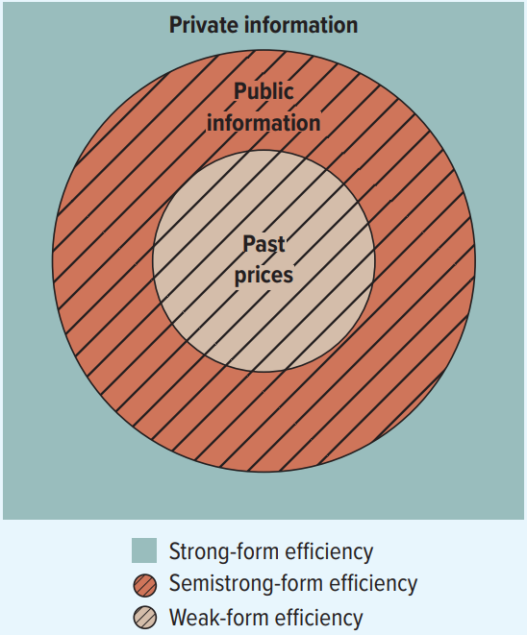
Three Forms of Market Efficiency
Weak Form
Prices reflect all information contained in the record of past prices and trading volumes. Technical analysis (using charts/patterns of past prices) cannot produce superior returns.
Semi-Strong Form [Orthodox View]
Prices reflect all publicly available information (past prices, accounting data, news, analyst reports). Neither technical nor fundamental analysis can produce superior returns.
Strong Form
Prices reflect all information, both public and private (insider information). Even corporate insiders cannot earn abnormal returns. This is the most extreme version and is generally considered too strong.

Slide 8
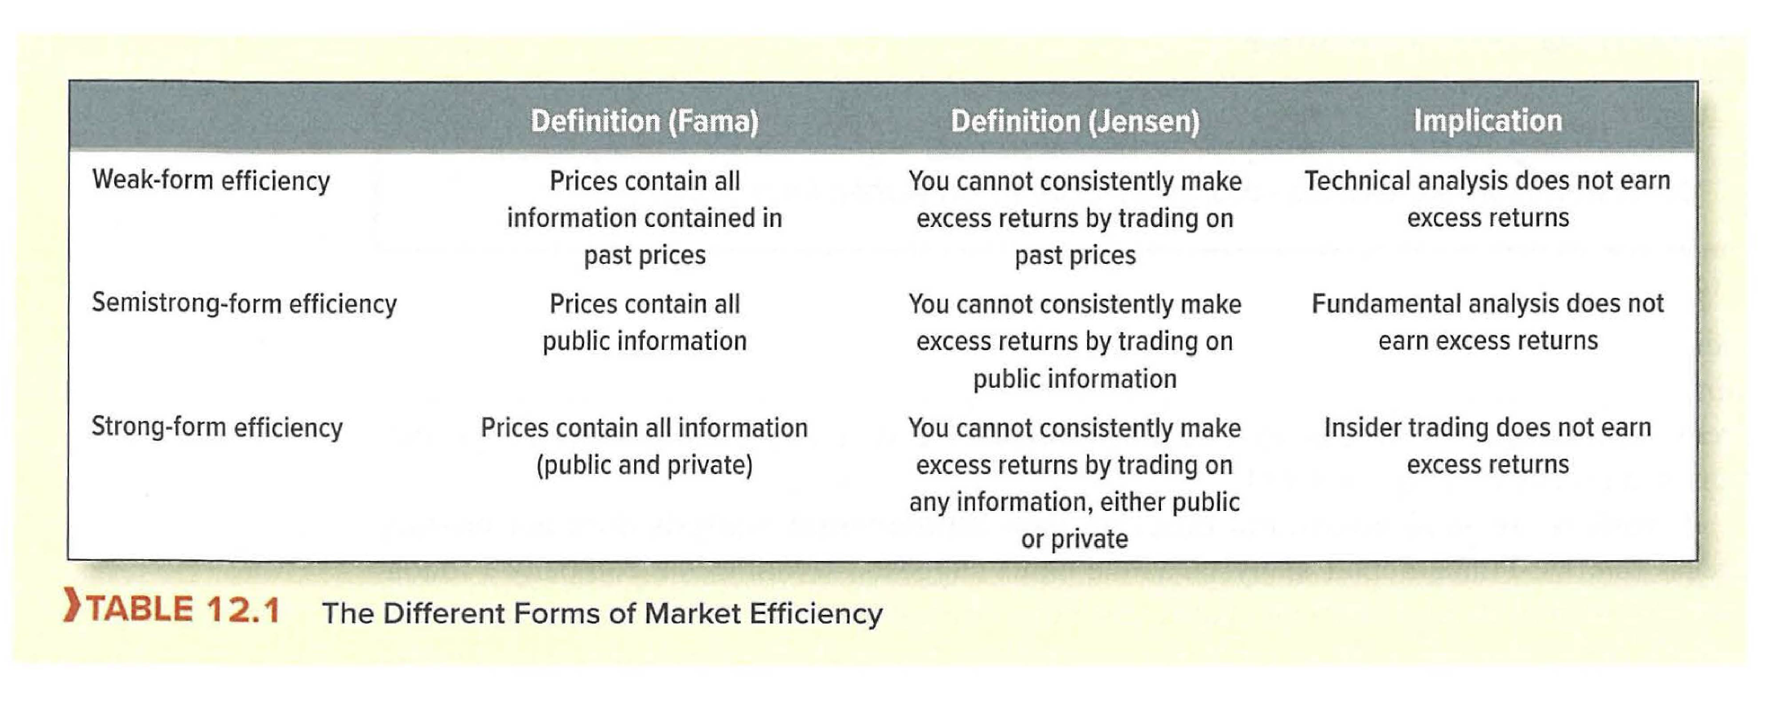
The Efficient Market Hypothesis

Slide 9
Why Are Markets Efficient?
Competition among investors drives efficiency
Professional investors and analysts constantly research and trade securities, seeking mispriced stocks.
Competition ensures that prices quickly adjust to new information.
The arbitrage mechanism:
If a stock is underpriced relative to available information, informed traders will buy it, pushing the price up to its fair value.
If overpriced, they will sell (or short sell), pushing it down.
Eugene Fama (1970) formalized the EMH. Michael Jensen (1978) defined it practically: “Prices reflect information to the point where the marginal benefits of acting on information do not exceed the marginal costs of collecting it.”

Slide 10
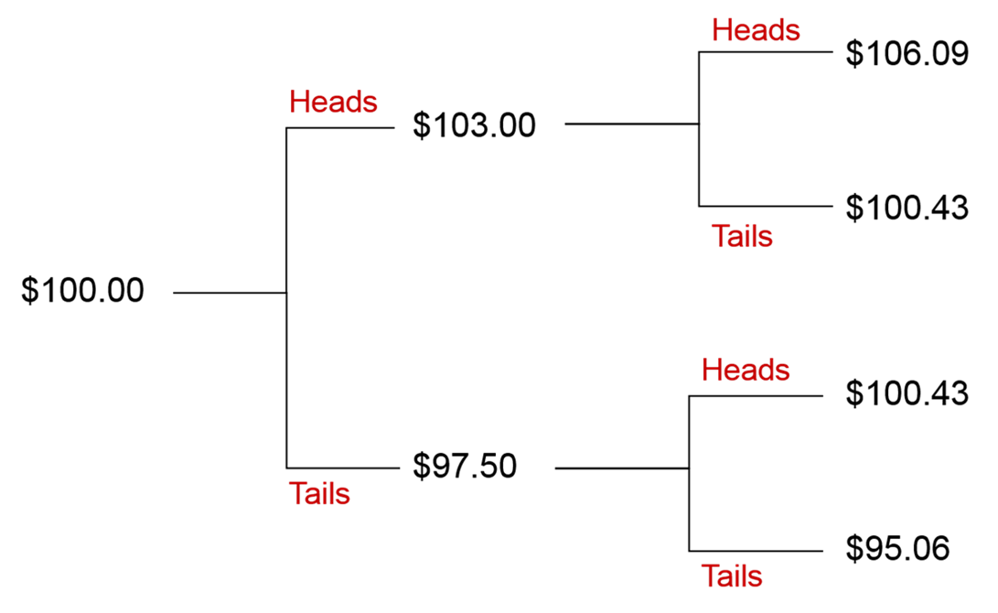
Implication 1: Prices Follow a Random Walk
Maurice Kendall (1953) found that stock price changes appeared random – no usable patterns.
This is actually evidence of efficiency, not irrationality:
If price changes were predictable, everyone would trade on that prediction, immediately eliminating the pattern.
In an efficient market, only genuinely new information causes price changes – and new information is, by definition, unpredictable.
Coin-toss analogy:
Simulated random coin-toss sequences look remarkably similar to actual stock price charts – both exhibit apparent “trends” and “cycles” that are actually just random fluctuations.
Serial correlation of price changes is close to zero for most stocks: knowing that a stock rose yesterday tells you almost nothing about whether it will rise or fall today.

Slide 11
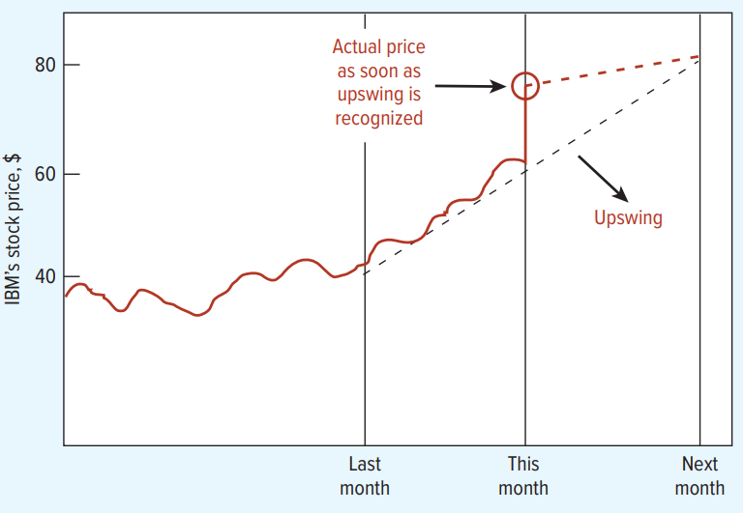
Implication 2: No Free Lunches
Self-destructing cycles:
If a pattern existed (e.g., prices always rise in January), traders would buy in December to profit, pushing December prices up and eliminating the January effect.
Any known pattern in prices will be traded away as soon as it is discovered.
The logic is powerful:
Suppose a fund manager discovers that small-cap stocks outperform in January. She buys them in late December. Others notice and do the same. Buying pressure pushes December prices up, reducing January returns. The anomaly self-destructs.
This is why market efficiency is maintained by the very act of trying to exploit inefficiencies.

Slide 12
Why Are Markets Efficient? (CAVEAT)
Caveat: Markets can never be “fully/truly” efficient.
It’s the hedge fund gathering information and then trading on it that makes markets efficient.
But the hedge fund only has incentives to do so if markets aren't fully efficient to begin with.
Under Fama’s definition, the hedge fund's information can’t yet be fully incorporated into prices, otherwise it won't trade.
Under Jensen's definition, the hedge fund needs to make at least a small return else it won't trade
Grossman and Stiglitz (1980): Market efficiency isn't a black-and white concept, because markets can never be perfectly efficient.
Market efficiency is more about the speed at which information is incorporated into prices (under Fama’s definition), and the speed at which you need to notice information and trade on it before the opportunity vanishes (under Jensen’s definition).
NB: Other traders can introduce noise. We will discuss this later.

Slide 13
“Good Company” ≠ “Good Investment”
Another way of stating the Grossman–Stiglitz (1980) Paradox:
If markets were perfectly efficient, no one would spend resources on research – there would be nothing to gain.
But without research, prices wouldn’t reflect information, and markets wouldn’t be efficient.
Resolution: Markets must be “sufficiently efficient” – leaving just enough profit opportunities to compensate analysts for their research costs.
This implies a competitive equilibrium: the marginal cost of information gathering equals its marginal benefit.

Slide 14
Implication 3: Trust Market Prices
If you believe markets are efficient, you should:
Hold a diversified portfolio (e.g., an index fund) rather than trying to pick individual stocks.
Avoid paying high fees for active fund management – most active managers do not beat the market after fees.
Focus on asset allocation and risk management rather than security selection.
The reasoning:
If all available information is already in the price, you cannot systematically identify undervalued stocks.
Trying to beat the market incurs costs (research time, transaction fees, tax consequences) that typically drag returns below the benchmark.

Slide 15
The Case for Index Investing
The SPIVA Scorecard (S&P Indices Versus Active):
Over 5 years, approximately 75–90% of actively managed funds underperform their benchmark index.
Over 10 years, the underperformance rate rises even further.
This pattern holds across equity styles (large-cap, small-cap, growth, value) and across countries.
Jack Bogle and the Vanguard Group:
Bogle founded Vanguard in 1975 and launched the first index mutual fund available to individual investors.
His logic was directly based on the EMH: if you can’t beat the market, match it at the lowest possible cost.
Vanguard’s low-cost index funds have since grown to manage trillions of dollars, vindicating the efficiency argument.

Slide 16
Implication 4: Read the Market Price
In an efficient market, prices convey accurate information:
The market price of a firm’s shares tells you what investors collectively think the firm is worth.
Managers can use market prices as signals (e.g., a falling share price may indicate problems).
Practical applications:
A CEO considering an acquisition can look at the target’s stock price to assess fair value.
Banks use market prices to evaluate collateral and creditworthiness.
Regulators monitor stock prices for signs of insider trading or market manipulation.
Event studies measure efficiency by examining abnormal returns around information events.

Slide 17
Event Study Methodology
Event studies measure how quickly prices adjust to new information:
Abnormal return = Actual return – Expected return (given market movements)
If markets are efficient, stock prices should adjust quickly to new information, with no predictable drift before or after the event.
Three-step methodology:
1. Estimate a stock’s normal expected return using a benchmark (e.g., CAPM or market model) over an estimation window prior to the event.
2. Calculate the abnormal return on the event date: AR = r – (α + β × r_market).
3. Cumulate abnormal returns (CARs) around the event window to measure the total price adjustment and detect any pre- or post-event drift.
The pattern of CARs reveals whether information was anticipated (pre-event drift) or took time to be incorporated (post-event drift).

Slide 18
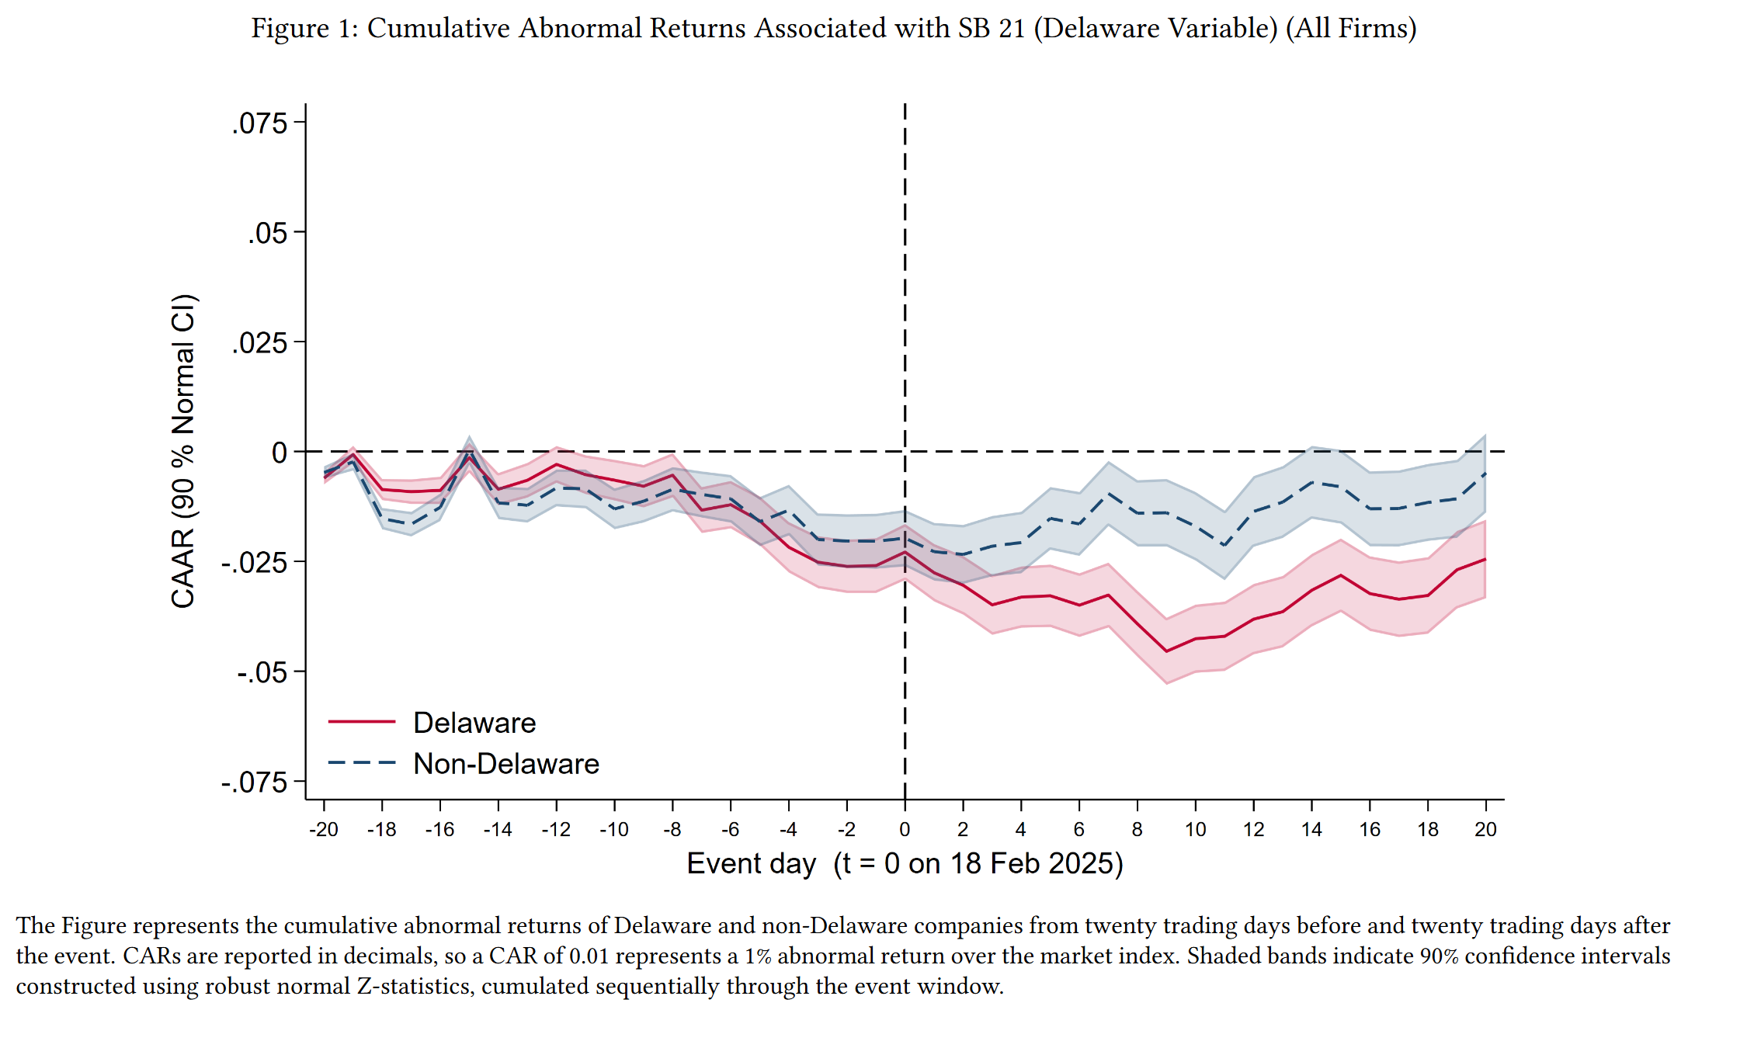
Event Study Methodology
Khoo and Tallarita (2025)

Slide 19
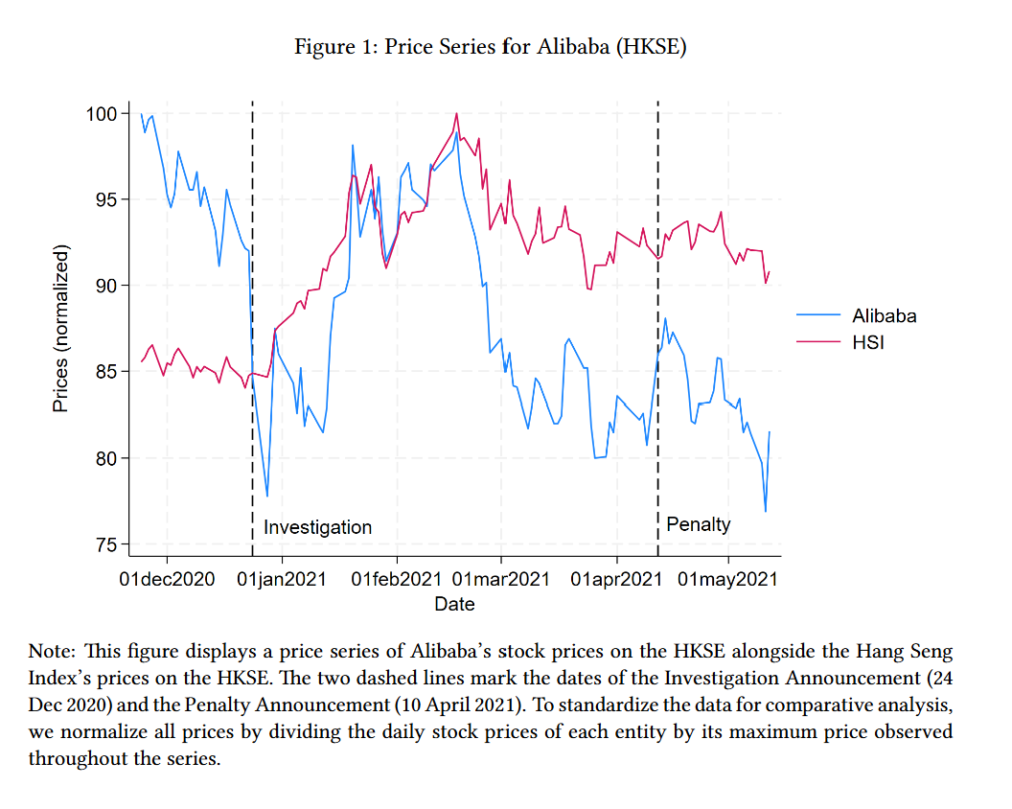
Event Study Methodology
Khoo et al. (2024)

Slide 20
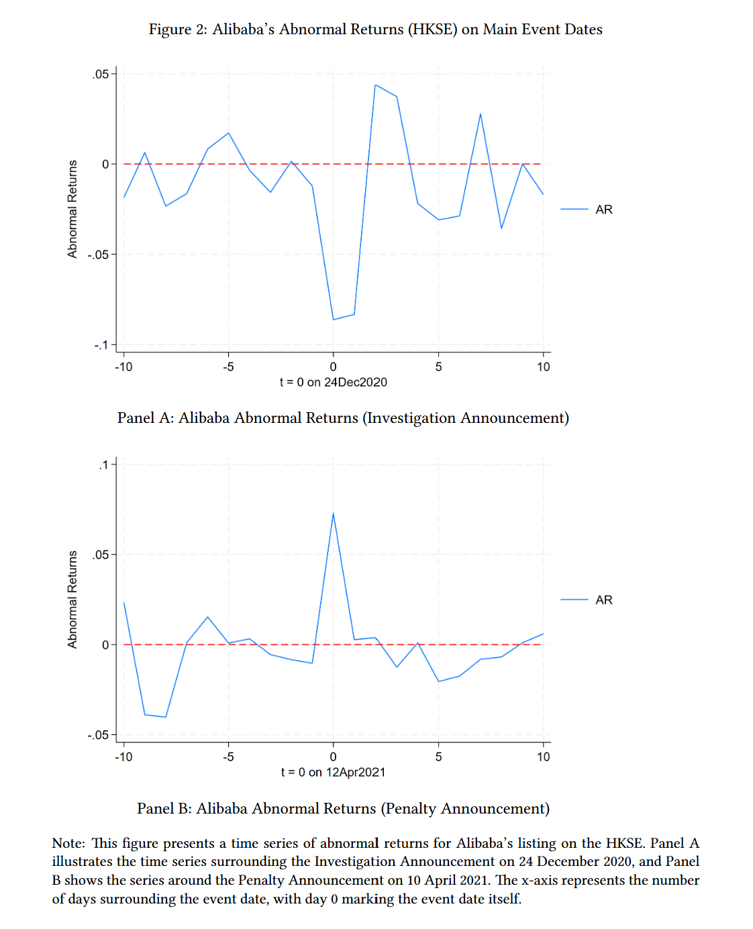
Event Study Methodology
Khoo et al. (2024)

Slide 21
Implication 5: Financing Decisions Don’t Create Value
If financial markets are efficient, the terms of a debt or equity issue are always fair.
This means:
Selling stock at the current market price has zero NPV.
Issuing bonds at the market interest rate has zero NPV.
Choosing between debt and equity cannot, by itself, create value.
Contrast with real asset markets:
Real assets (factories, patents, brand) can generate positive NPV because of barriers to competition.
Financial markets lack these barriers – securities are traded in highly liquid, transparent markets.
Exception: Financing can create value through tax shields, subsidies, or information effects – but these arise from market imperfections, not from “outsmarting” the market.

Slide 22
What EMH Does NOT Imply (Part 1)
“Prices are always stable”
Market efficiency does NOT mean no volatility. Prices change – sometimes dramatically – as new information arrives. Efficiency means prices reflect current information, not that they never move. High volatility may simply reflect a period of rapid information flow.
“Investors can’t make money”
Investors earn a normal expected return for bearing risk. EMH says you cannot consistently earn ABNORMAL returns (above what is justified by your risk exposure). Patient, diversified investors can still build wealth over time.
This is way factor models (see Slide Deck 7) give rise to abnormal returns—you are essentially collecting “insurance payments” for bearing excess risk.

Slide 23
What EMH Does NOT Imply (Part 2)
“All investors earn the same return”
Different investors choose different risk levels and therefore earn different expected returns.
EMH only says you can’t earn higher risk-adjusted returns through information advantages.
A portfolio of risky stocks should earn more than T-bills on average.
“Price = true value at all times”
Prices can deviate from fundamental value temporarily. EMH says these deviations are random and cannot be systematically exploited.
Prices are the best available estimate, not a perfect one. Mispricings may exist, but they are unpredictable.

Slide 24
Implications of Market Inefficiency: Financing Decisions
If markets are NOT efficient, financing decisions can create value:
A company that believes its stock is overvalued should issue equity (selling overpriced shares to raise cheap capital).
A company that believes its stock is undervalued should buy back shares or avoid issuing equity (to prevent diluting existing shareholders at a low price).
Market timing in corporate finance:
Baker and Wurgler (2002) found that firms are more likely to issue equity when their market valuations are high.
This is consistent with managers attempting to “time the market” – exploiting perceived overvaluation.
If you believe in efficiency: financing decisions don’t matter for value. Focus on real investment decisions.
If you believe in inefficiency: there is scope for strategic financing decisions to exploit mispricings.

Slide 25
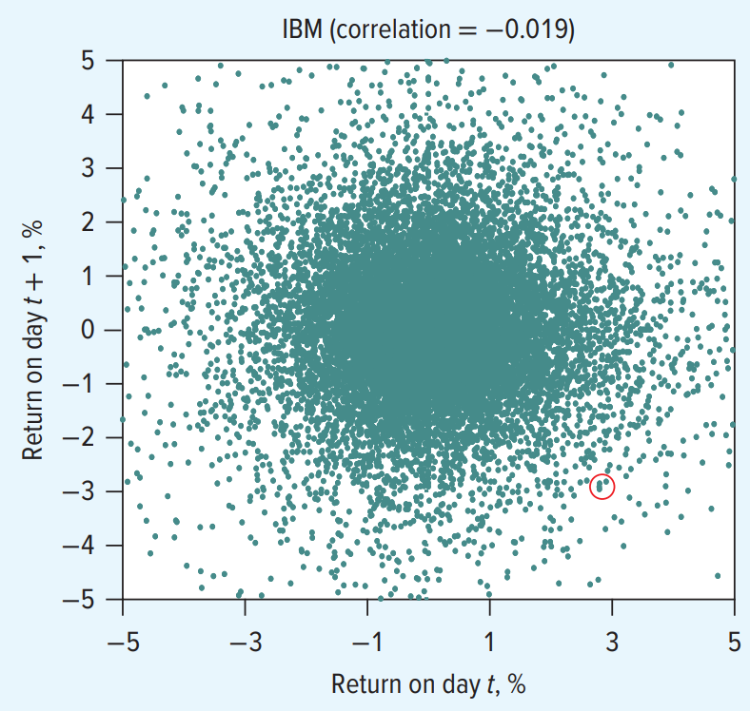
Evidence: Weak-Form Efficiency
What about the empirical evidence on EMH?
Serial correlation tests (Fama, 1965):
Measured correlation between successive daily returns for major stocks.
Results: Correlations were extremely small (e.g., IBM: +0.017, Carrefour: –0.014, Toyota: –0.011, Unilever: –0.011).
These are statistically and economically insignificant – past returns have virtually no predictive power for future returns.
Trading rule tests:
Researchers tested hundreds of technical trading rules (moving averages, support/resistance, filter rules).
After adjusting for transactions costs, no rule consistently outperforms a buy-and-hold strategy.
Overall verdict: Some support for weak-form efficiency. Day-to-day price changes are essentially random and cannot be profitably exploited using past price data alone.

Slide 26
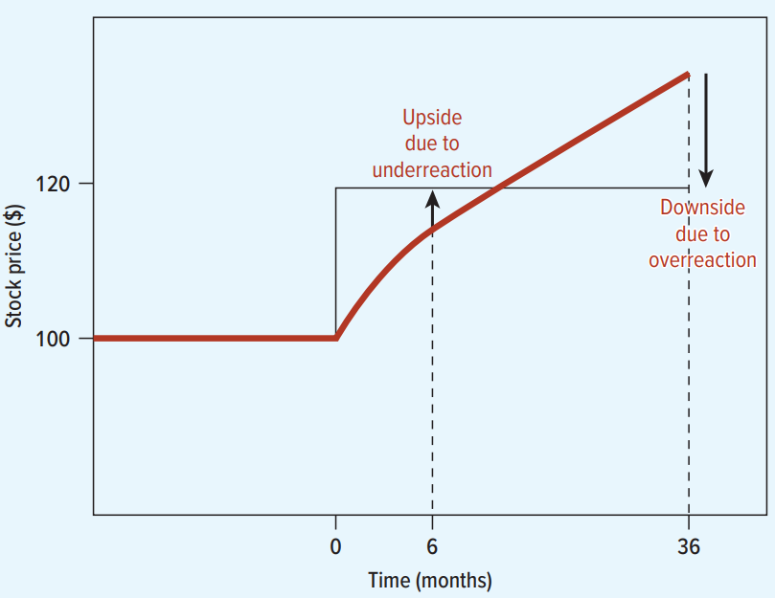
Anomalies: Momentum and Long-Run Reversal
Short-term momentum (3–12 months):
Jegadeesh & Titman (1993): Stocks that performed well over the past 3–12 months tend to continue performing well.
A strategy of buying recent winners and selling recent losers earns abnormal returns of roughly 1% per month.
Momentum is one of the most robust anomalies and is found across many markets and time periods.
Long-run reversal (3–5 years):
De Bondt & Thaler (1985): Stocks that performed poorly over 3–5 years tend to subsequently outperform, and vice versa.
This suggests markets may overreact to information over longer horizons.
Debate: Are these genuine mispricings or compensation for risk? Fama & French argue momentum survivors are riskier; behavioralists argue these reflect investor biases (overreaction and underreaction).

Slide 27
Evidence: Semi-Strong Form – Active Fund Performance
The SPIVA Scorecard (S&P Indices Versus Active) tracks fund manager performance:
Key findings (percentage of funds underperforming their benchmark):
U.S. Large-Cap: 88% underperform over 5 years; 92% over 15 years.
U.S. Mid-Cap: 86% underperform over 5 years.
U.S. Small-Cap: 86% underperform over 5 years.
International (Developed): 86% underperform over 5 years.
Emerging Markets: 89% underperform over 5 years.
Even the few fund managers who outperform in one period tend not to repeat their outperformance in the next.
This is strong evidence that professional analysts with access to all public information still cannot consistently beat the market after fees and costs.

Slide 28
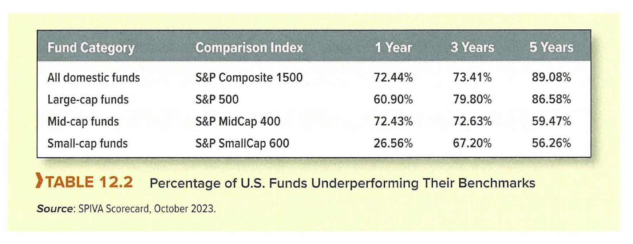
Evidence: Semi-Strong Form – Active Fund Performance

Slide 29
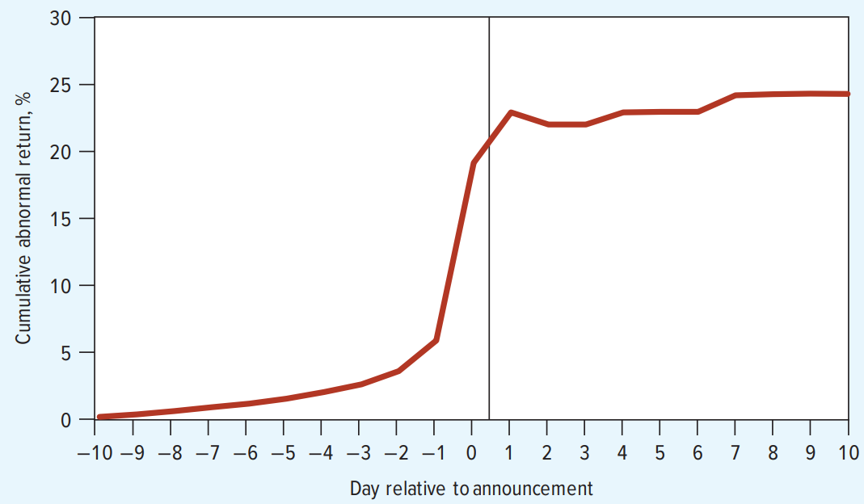
Evidence: Semi-Strong Form – Event Studies
Takeover announcements:
When a takeover bid is announced, the target’s stock price jumps immediately – typically by 20–40%.
Almost all of the price adjustment occurs on the announcement day or within days.
There is no significant continued drift upward after the announcement – consistent with semi-strong efficiency.
Evidence of information leakage:
Target stock prices often start rising in the weeks before the public announcement.
This suggests some leakage of private information or insider trading before public disclosure.
Implication: Markets respond rapidly and accurately to new public information. The main question is how information gets into prices (publicly vs. through informed trading).

Slide 30
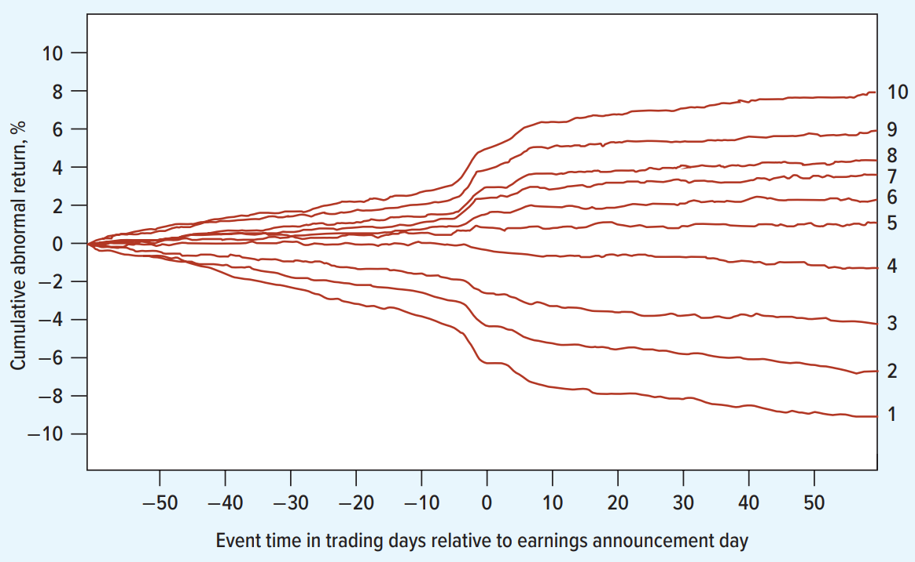
Evidence: Post-Earnings-Announcement Drift
Post-earnings-announcement drift (PEAD) is one of the most well-documented anomalies:
Finding:
Stocks that report unexpectedly good earnings tend to drift upward for 60+ days after the announcement.
Stocks that report unexpectedly bad earnings tend to drift downward for 60+ days.
This violates semi-strong efficiency:
If markets were semi-strong efficient, the full price adjustment should occur at the announcement, not gradually over months.
The drift suggests investors underreact to earnings news and only slowly incorporate the full implications.
However: Trading costs and risk adjustments may explain some of the drift. After transaction costs, the abnormal returns may not be large enough to exploit profitably.

Slide 31
Evidence: Strong-Form Efficiency
Strong-form efficiency says no one – not even insiders – can earn abnormal returns.
Evidence against strong-form efficiency:
Corporate insiders (officers, directors) who trade their own company’s stock earn significantly higher returns than the market.
Studies show insiders earn abnormal returns of 3–8% per year on their trades.
Legal framework:
Most countries have insider trading laws that prohibit trading on material non-public information.
The existence and enforcement of these laws implicitly acknowledges that insiders do have informational advantages.
Conclusion: Strong-form efficiency is generally viewed as a “rejected” hypothesis. Insiders do have information advantages. The practical question is the degree to which other forms of “private” information (analyst insights, fund manager research) can produce abnormal returns.

Slide 32
Behavioral Finance
Behavioural finance challenges the assumption that investors are fully rational:
Draws on psychology to explain how cognitive biases and emotional factors affect financial decisions.
Three main categories of behavioral departures:
Attitudes toward risk (preferences) – People do not evaluate risky gambles as standard theory predicts.
Beliefs about probabilities – People make systematic errors in assessing the likelihood of events.
Sentiment – Investor mood and social dynamics can drive prices away from fundamentals.
Important distinction: Even if individual investors are irrational, the market as a whole could still be efficient if irrational trades cancel out or are corrected by arbitrageurs. Behavioural finance argues that sometimes they do not cancel out.

Slide 33
Behavioral Finance: Prospect Theory
Prospect Theory (Kahneman & Tversky, 1979):
People evaluate outcomes relative to a reference point (often the purchase price), not in absolute terms.
The pain of a $1 loss is felt roughly 2–2.5× more intensely than the pleasure of a $1 gain (loss aversion).
The value function is concave for gains (risk-averse) but convex for losses (risk-seeking).
Key insight:
Traditional finance assumes investors care about final wealth levels. Prospect theory says they care about changes relative to a reference point.
This means the same outcome can feel like a gain or a loss depending on the starting point – violating the rational investor assumption.

Slide 34
Prospect Theory: Market Consequences
Disposition effect:
Investors tend to sell winners too early (locking in gains) and hold losers too long (avoiding the pain of realizing a loss).
This is irrational: tax considerations alone suggest doing the opposite (sell losers for tax-loss harvesting).
Risk-seeking in losses:
When facing losses, investors become more willing to gamble, doubling down on losing positions rather than cutting losses.
Myopic loss aversion:
Investors who check their portfolio frequently feel more pain (since short-term losses are common) and may demand a higher equity premium as compensation.
The equity premium puzzle:
Historically, stocks have returned ~7% more than T-bills per year – far more than standard models predict.
Prospect theory with loss aversion may help explain why investors demand such a large premium for bearing equity risk.

Slide 35
Cognitive Biases: Overconfidence and Representativeness
Overconfidence:
Investors overestimate the precision of their forecasts and their ability to pick stocks.
Studies show that individual investors who trade most frequently earn the lowest net returns (Barber & Odean, 2000).
Excessive trading reduces returns due to transaction costs, bid-ask spreads, and tax consequences.
Representativeness (base rate neglect):
Investors give too much weight to recent patterns and too little to long-run base rates.
Leads to extrapolation bias: assuming recent trends (good or bad) will continue indefinitely.
Example: After a bull market, investors expect continued growth; after a crash, they expect further declines.
This helps explain momentum in the short term and overreaction in the long run.
See: Khoo et al. (2025) (working paper)

Slide 36
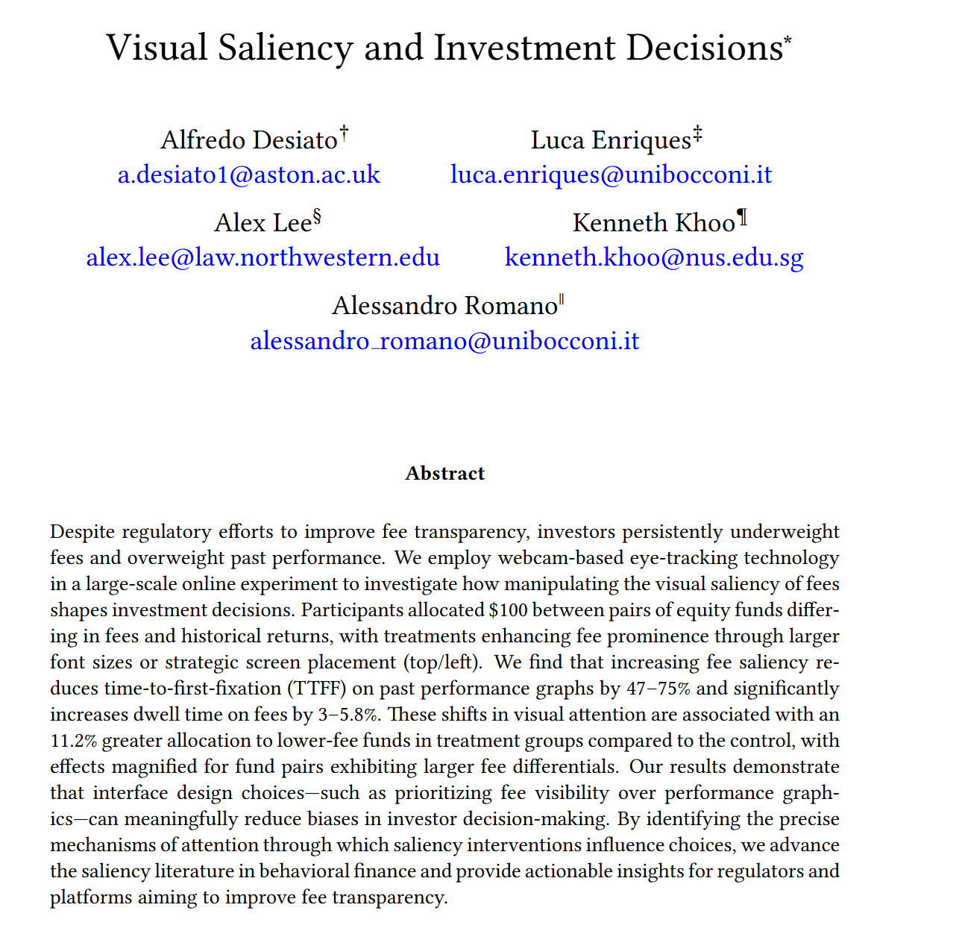
Cognitive Biases: Overconfidence and Representativeness

Slide 37
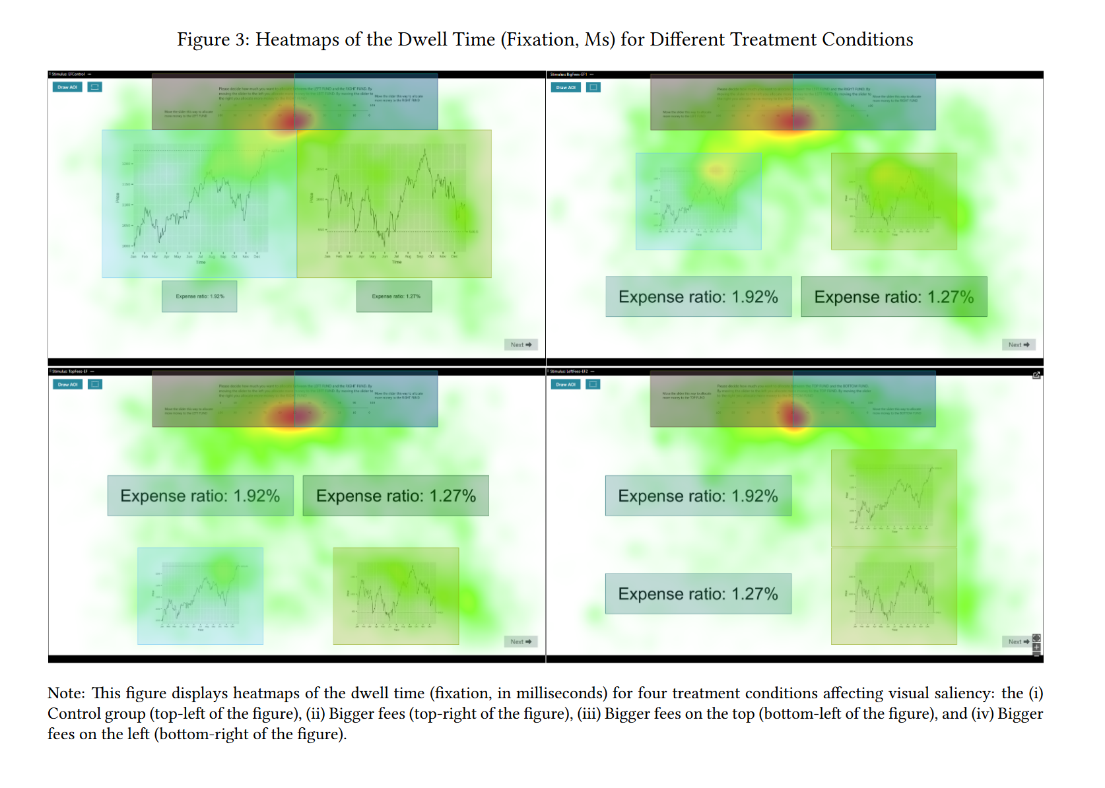
Cognitive Biases: Overconfidence and Representativeness

Slide 38
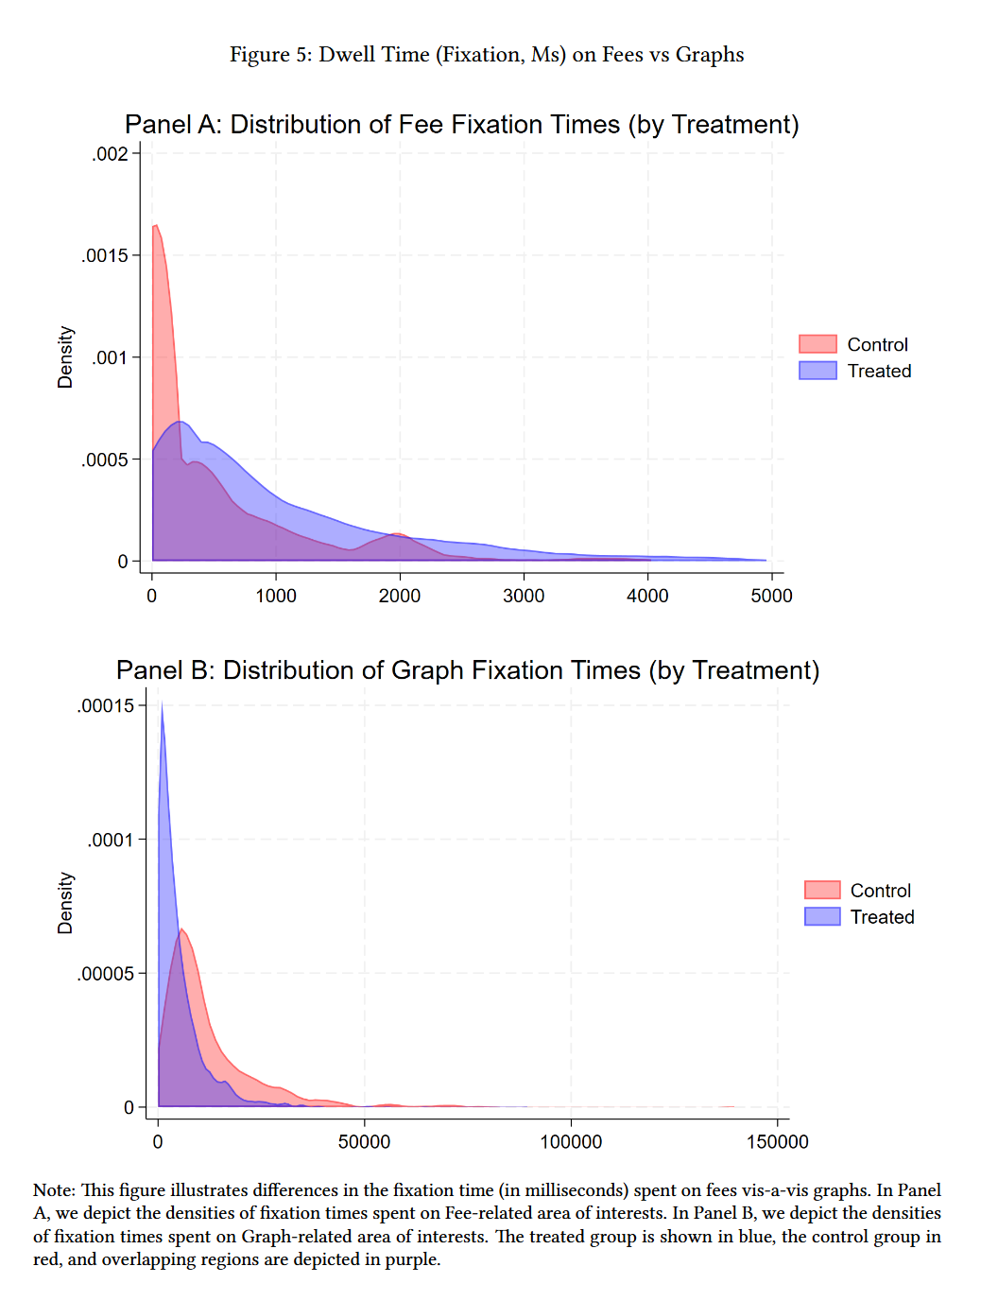
Cognitive Biases: Overconfidence and Representativeness

Slide 39
Cognitive Biases: Conservatism and Confirmation Bias
Conservatism (underreaction):
Investors are slow to update their beliefs when new evidence arrives.
They anchor on prior expectations and adjust insufficiently to new data.
Helps explain post-earnings-announcement drift: prices continue drifting in the direction of the earnings surprise for weeks after the announcement.
Confirmation bias:
Investors seek information that confirms existing beliefs and ignore or discount contradictory evidence.
A bullish investor reads positive news about a stock while dismissing warning signs.
Combined effect:
These biases can cause systematic mispricing: slow incorporation of information (conservatism) followed by eventual overreaction (representativeness), creating predictable return patterns.

Slide 40
Investor Sentiment
Market-wide mood swings can push prices away from fundamental values:
Periods of optimism (bubbles): Investors bid up prices beyond justified levels, driven by greed and fear of missing out.
Periods of pessimism (crashes): Prices fall below fundamentals, driven by panic and herd behavior.
Historical examples:
Dot-com bubble (1999–2000): Internet stocks reached extraordinary valuations with little or no revenue. The Nasdaq fell ~78% from peak to trough.
Housing bubble (2004–2007): Mortgage-backed securities were priced as if housing prices could never fall. The subsequent crash triggered the Global Financial Crisis.
Sentiment is difficult to measure but proxies include:
Investor surveys, mutual fund flows, IPO volume, and the VIX (volatility index).

Slide 41
Data Mining and False Patterns
The data mining problem:
With enough data, you can always find correlations that appear significant but are spurious.
If you test 100 trading strategies, about 5 will appear “statistically significant” at the 5% level purely by chance.
Famous example:
The “Super Bowl Indicator”: stock market performance was correlated with which team won the Super Bowl: This is a coincidence, not a real trading signal.
Challenge for researchers:
Many published “anomalies” may be the result of data mining rather than genuine market inefficiency.
Robustness testing across different markets, time periods, and sample sizes is essential.

Slide 42
Limits to Arbitrage
Even if a mispricing exists, arbitrageurs may not be able to correct it:
Short-selling constraints and the “short squeeze risk”:
To profit from an overpriced stock, you must short sell it – but short selling involves borrowing shares, which can be costly or impossible for some securities.
Short sellers face potentially unlimited losses if the stock keeps rising.
If many traders have shorted a stock, a sudden price increase can force them to buy back shares at a loss, driving the price even higher.
This creates a feedback loop that can push prices further from fundamentals.
Agency and horizon problems:
Professional arbitrageurs manage other people’s money. If a position moves against them, investors may withdraw funds, forcing them to close positions at a loss.
“Markets can stay irrational longer than you can stay solvent.”—often attributed to Keynes.

Slide 43
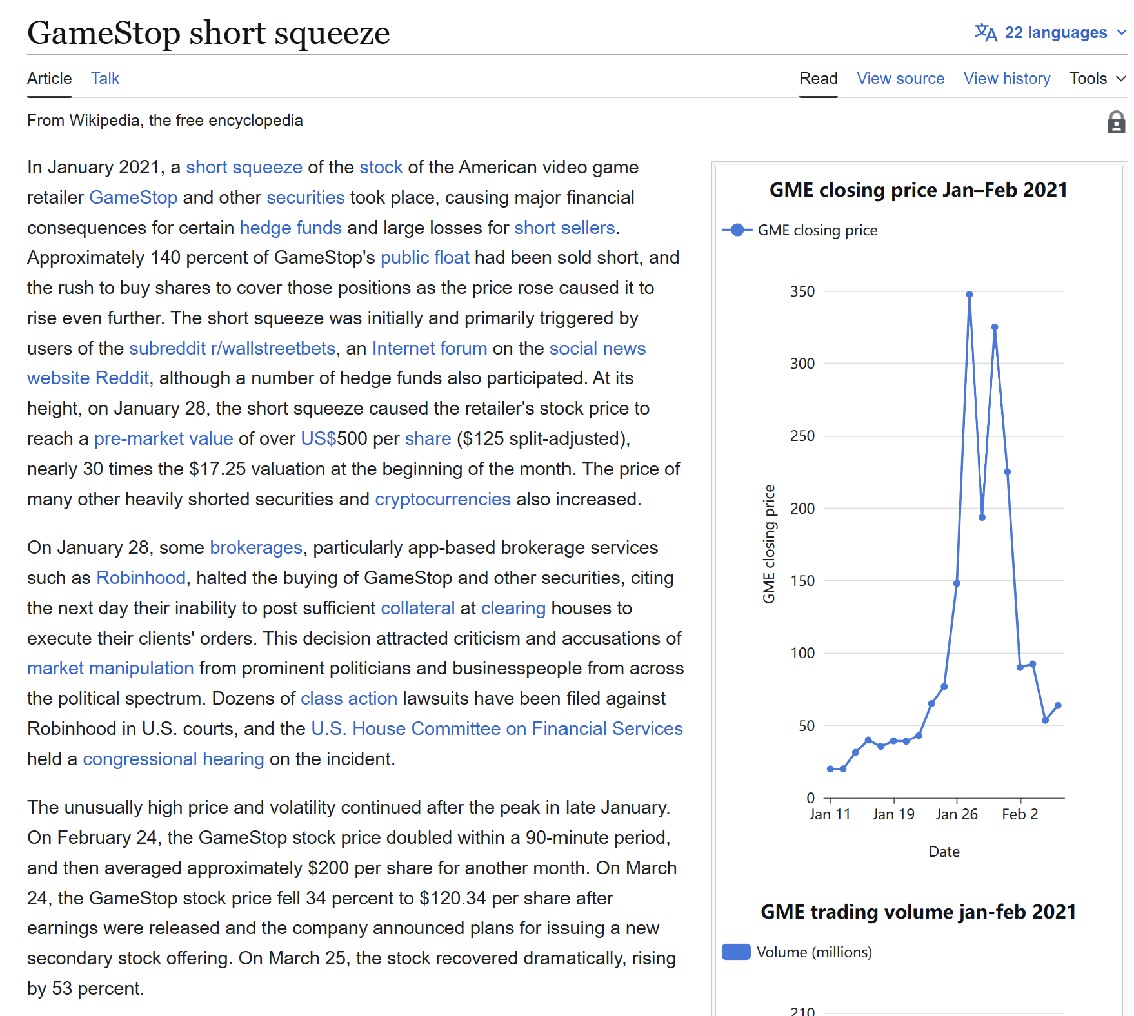
Limits to Arbitrage

Slide 44
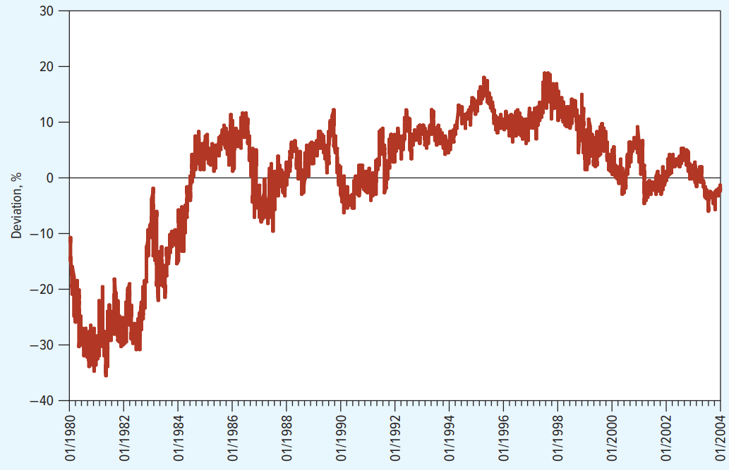
Case Study: Royal Dutch Shell and the Limits of Arbitrage
Royal Dutch Petroleum and Shell Transport were “twin” companies:
Both shared the same underlying cash flows, split 60/40.
In theory, Royal Dutch should always trade at 1.5× Shell’s value.
In reality:
The price ratio deviated from the theoretical 60/40 split by as much as 35%.
These deviations persisted for years despite being an obvious mispricing.
Why couldn’t arbitrage fix it?
Arbitrageurs (including LTCM) did trade on this mispricing – but the mispricing widened further before correcting.
When the 1998 financial crisis hit, the deviation grew, and funds like LTCM faced margin calls and forced liquidation.
Lesson: Even clear mispricings can persist if arbitrageurs face funding risk, short-selling costs, and uncertainty about when (or if) convergence will occur.

